Slide 1
Aerospace Design and Systems Engineering Elements II AE2111-II aircraft part
Dr. Fabrizio Oliviero
Flight Performance & Propulsion Group (FPP)
Intro & fundamentals on Aircraft aerodynamic designs

Slide 2
0. AE2111-II Aircraft part
A brief overview
Notes:
2

Slide 3
Agenda for the AE2111-II, aircraft part
Number | Date | Topic
1 | 05/09 | Fundamentals on wing aerodynamics
2 | 06/09 | Calculation of aero characteristics
3 | 10/09 | Aero sub system of the wing
4 | 12/09 | Utilization of aero software
5 | 13/09 | Weight estimation models

Slide 4


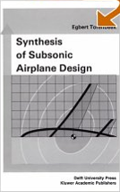
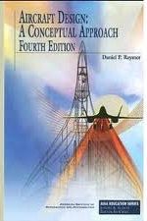
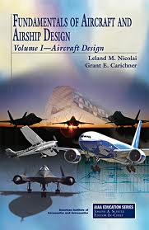
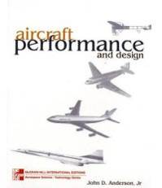
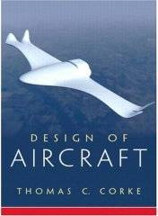
How to study for this part?
You will find most of the study material stored in the Lectures/Aircraft Part section on BrightSpace.
Study material mainly consists of lecture notes, plus a number of other relevant documents you are recommended to read/use. Those documents are reported on Brightspace in the section relative to each lecture
Lecture notes will be posted on BS at the end of each class. Even before when possible…
Updated versions might be posted during the course when the need arises (a sequential version number will be indicated and the relevant changes highlighted)
Torenbeek
Raymer
Nicolai
Anderson
Roskam (series)
Corke

Slide 5


About the content of the slides
The slides presented and discussed in class often contain extra information in the notes section.
In addition there are a number of hidden slides that are ot discussed in classroom only for time reason: those ones are equally important and their content could be asked in the exam!
this attention sign you often find on slides is meant to bring your attention on a particular point. Generally a corresponding comment is reported in the notes section.

Slide 6
Setting the right expectation on the contents
Some disclaimer are needed to use at best the topic discussed in the coming 5 lectures and to face in general aircraft design in the bachelor program:
An aircraft designer relies on a number of disciplines: aerodynamics, structures, flight mechanics, etc… Even though we focus the attention on the first one, al the other aspect are not secondary, and they cannot be discarded.
Aircraft design focus on the application of different fundamental theories. Due to the placement in the Y2 program, we have to “give for granted” some concepts and theories that will be discussed later on in other courses.
We focus on procedures, and we’ll explain the main equations; those will be given in a formula sheet for the exam. Nevertheless some basics definition need to be known by hart!

Slide 7
1. Aerodynamic design
Introduction
Notes:
7

Slide 8
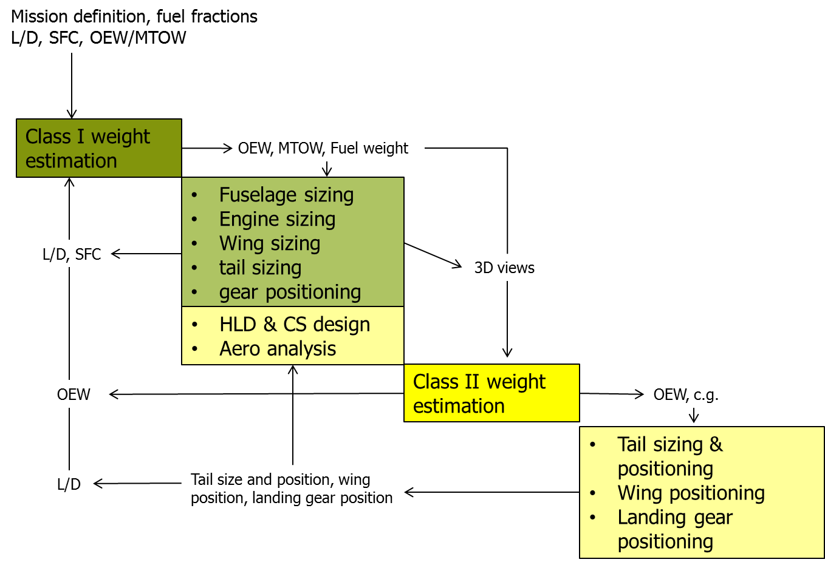
Objective(s) of this lecture
Identification of the main aerodynamic curves
Qualitative dependence of the aerodynamic characteristics on:
Geometry (Airfoil and wing planform)
Flow conditions

Slide 9
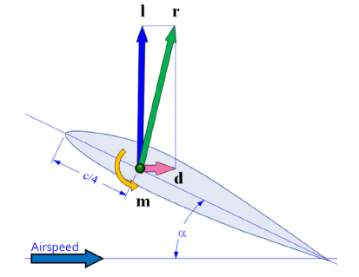
Aerodynamic Forces
Lift: the aerodynamic force normal to the freestream
Drag: the aerodynamic force parallel to the freestream
Pitching moment: aerodynamic moment around a reference point
Usually around the quarter chord point or the aerodynamic center
Aerodynamic coefficients:
Notes:
q is the dynamic pressure defined as 0,5*rho*V^2
Sref is the reference area, which is usually the wing total area (will be defined later in this lecture)
C_bar is the mean aerodynamic chord (will be defined later in this lecture)
For aerodynamic forces and coefficients, small letters, l,d and m, are used for airfoil (i.e. Cl, Cd, Cm) and capital letters are used for 3D wing (i.e. CL, CD, CM)
Cl, Cm and Cd = f (α, Re, M)
The performance of a given airfoil depends mainly on
angle of attack,
Reynolds number (viscosity effect). Typical values of Re (ρVx/μ) are between 500000 and 6 millions for most of general aviation aircraft and higher than 9 millions for airliners or fighters. (By definition Re depends on aircraft speed and flow characteristics, but also on the size of the body immersed in the flow, hence the flow around a large aircraft is characterized by a larger Re value, than a smaller aircraft, flying at the same conditions!). This dependency on the size is such that in a tapered wing designed using only one airfoil, the behaviour of the root section is different than the tip section behaviour (see more of this when discussing about wing stall characteristics)
Mach number (compressibility effect).

Slide 10
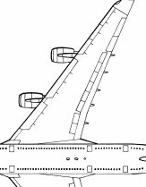
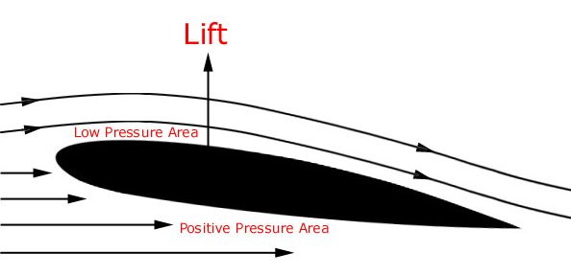
Wing airfoil and planform
From the design point of view, a 3D wing design can be categorized into two parts:
Airfoil design: wing’s cross-sectional shape
Planform design : the projection of the wing’s shape when looking top-down
This decoupling is done just to have a design framework. In practice, both 2D airfoil and 2D planform effects combine in determining the final 3D aerodynamic behaviour.

Slide 11
1.1 Airfoil Aerodynamics
Notes:
11

Slide 12
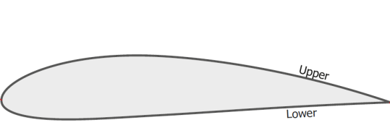
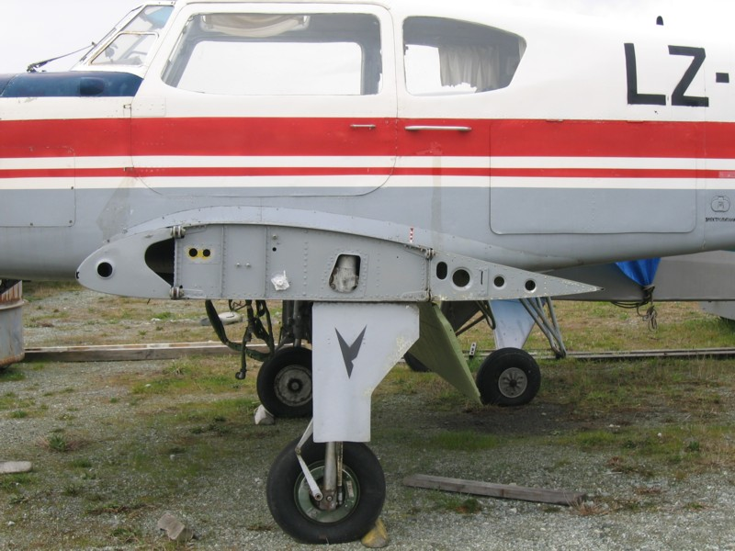
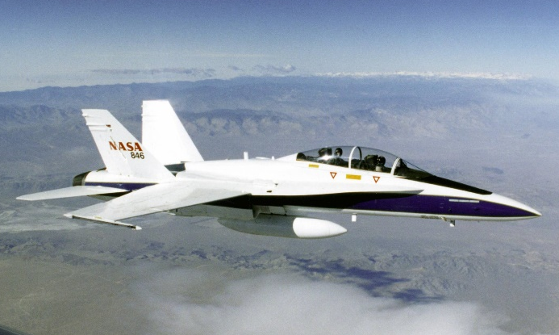
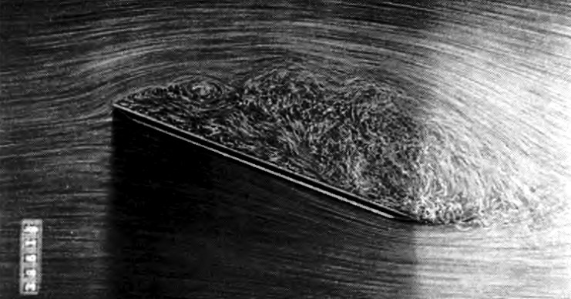
Airfoil: a definition
Definition of an airfoil:
The airfoil is a streamlined (=slender) body able to provide useful forces (for motion) when immersed in a flow with certain conditions (of speed and angle of attack namely).
The airfoil is defined by means of its function and not depending on the geometric characteristics.

Slide 13

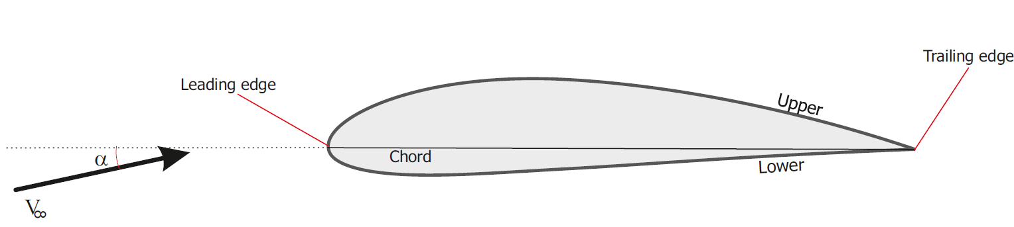
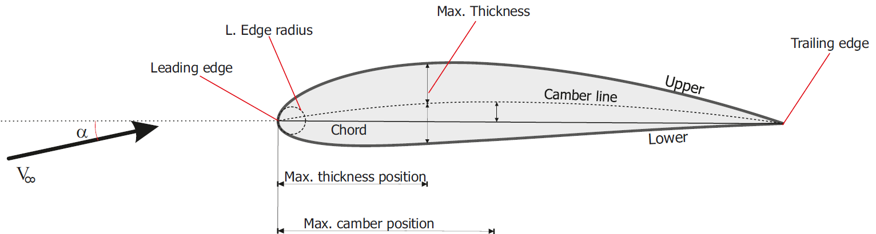
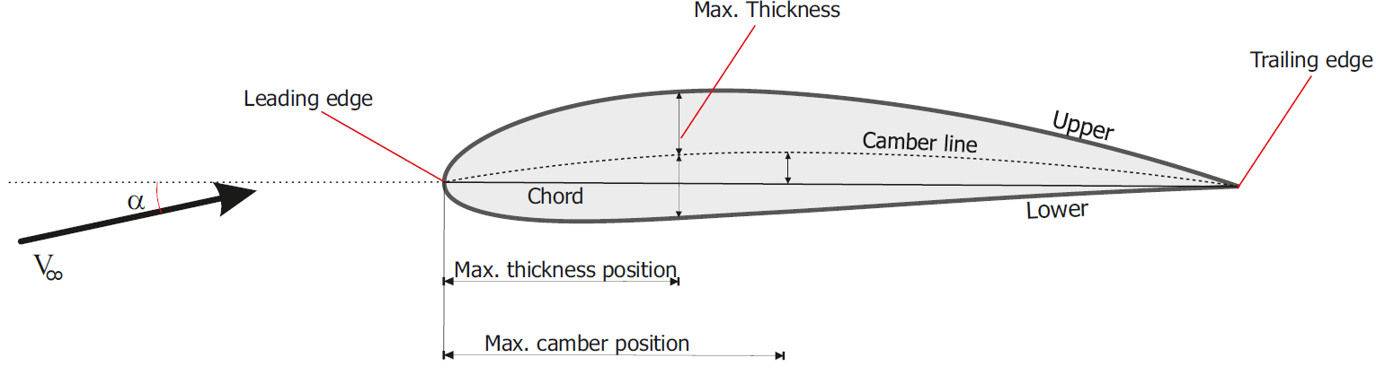
Airfoil: a geometry definition
Common subsonic/transonic airfoil used for aircraft application, present a variety of geometric parameters:
Notes:
The medium or mean camber line (or airfoil mean line) is the line equidistant (distance measured orthogonally to the camber line itself!) in every point from the upper and lower airfoil curves.
The chord is by definition the straight line going from the TE point (or half the TE thickness in case of not sharp tail airfoil) to the farthest point on the airfoil, which is by definition the LE point on the airfoil. LE and TE point represent also the start and end point of the camber line.
The total airfoil camber is measured as the maximum distance between the camber line and the chord line, measured normally to the chord and typically expressed as percentage of the chord length. The position of the maximum camber is also an important characteristic describing the airfoil. It is typically indicated as a percentage of the chord length.
The thickness of the airfoil is measured normally to the chord line. The maximum thickness value as well as its position are important parameters affecting the behaviour of an airfoil.
The angle of attack α is measured as the angle between the direction of the freestream velocity (V∞) and the chord.

Slide 14

Approximation of an Airfoil
Cross-sectional Area
Fig. source: Gudmundsson

Slide 15
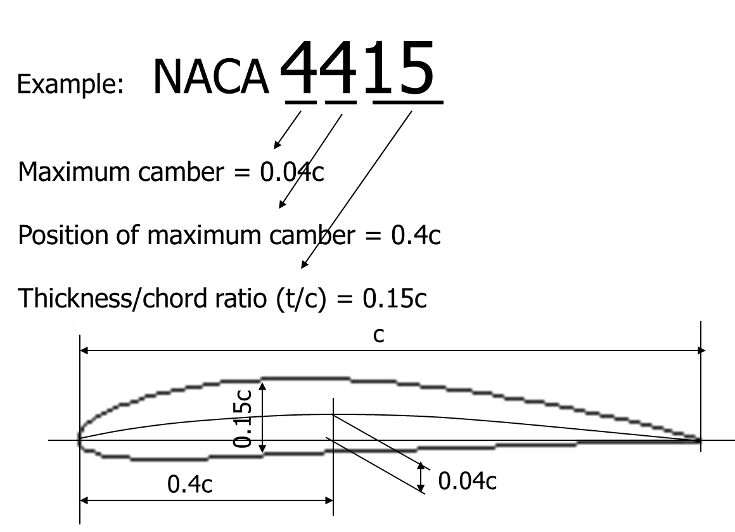
Airfoil families
Thousands of airfoil are nowadays used for a wide range of applications (fixed and rotating wings, turbine blades, marine props etc…).
Most of them are grouped into family: among all the families, the NACA airfoils are still widely used for fixed wing application, because its coding system.
NACA
4 digits
6 digits (laminar)
5 digits
…

Slide 16
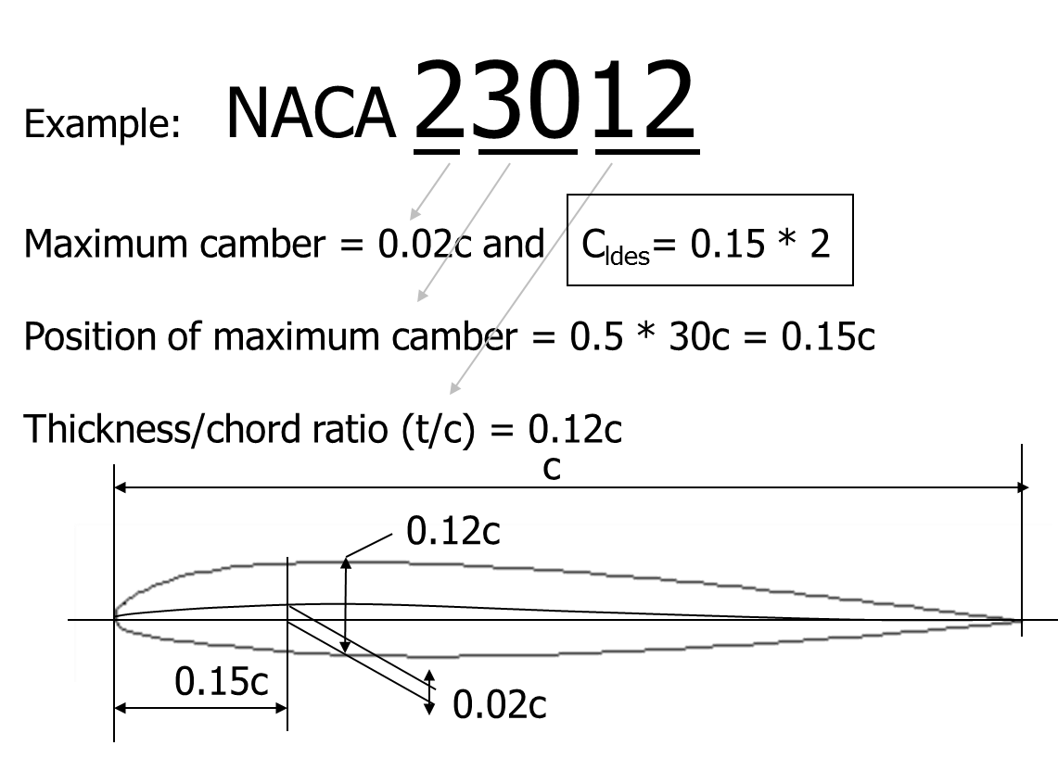
Airfoil families
Thousands of airfoil are nowadays used for a wide range of applications (fixed and rotating wings, turbine blades, marine props etc…).
Most of them are grouped into family: among all the families, the NACA airfoils are still widely used for fixed wing application, because its coding system.
NACA
4 digits
6 digits (laminar)
5 digits
…

Slide 17
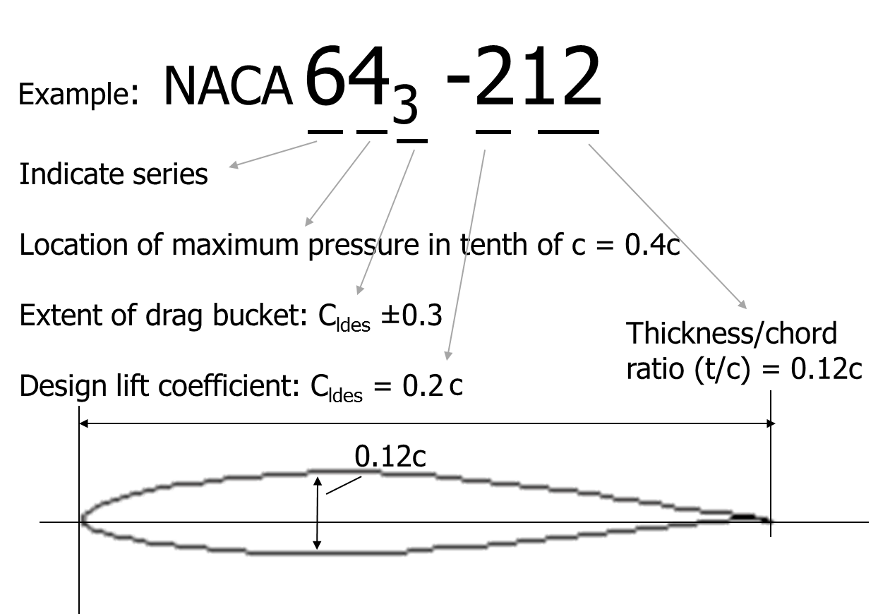
Airfoil families
Thousands of airfoil are nowdays used for a wide range of applications (fixed and rotating wings, turbine blades, marine props etc…).
Most of them are grouped into family: among all the families, the NACA airfoils are still widely used for fixed wing application, because its coding system.
NACA
4 digits
6 digits (laminar)
5 digits
…

Slide 18
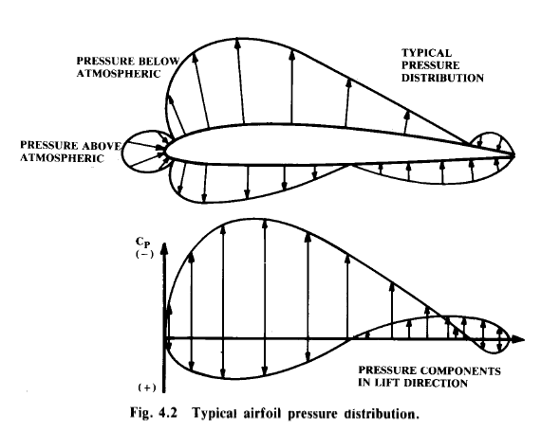
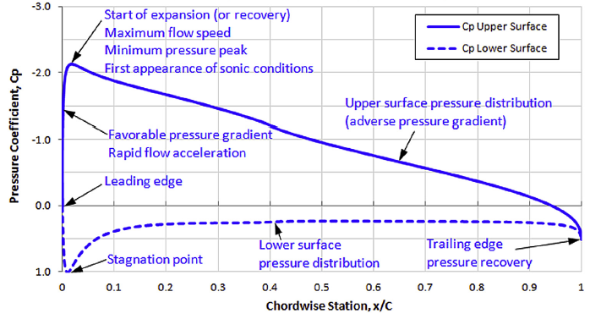
Airfoil pressure field
Pressure coefficient
Notes:
A generic airfoils perturbs the freestream velocity with its presence. The flow is forced to deviate and accelerates along the boundary of the airfoil.
This acceleration generates a field of pressure forces acting on the airfoil.
The component normal to the freestream of the of pressure forces resultant is defined as lifting force; the component parallel to the freestream direction is the drag.
The aerodynamic performance of airfoil sections can be studied by reference to the pressure distribution over the airfoil. This distribution is usually expressed in terms of the pressure coefficient Cp.
Cp is defined as the difference between local static pressure (p) and freestream static pressure (p∞), normalized with the freestream dynamic pressure (1/2ρV²).
x/c varies from 0 at the leading edge to 1.0 at the trailing edge. C_{p} is normally plotted "upside-down" with negative values (suction), on the upper part of the plot. This is done so that the upper surface of a conventional lifting airfoil corresponds to the upper curve.
The C_{p} value starts from about 1.0 at the stagnation point, near the leading edge. It rises rapidly (i.e., the pressure decreases) on both the upper and lower surfaces and finally recovers to a small positive value of C_{p} near the trailing edge.
The pressure distribution integrated around the airfoil is the airfoil lift force l. This lift force normalized with the airfoil chord length and the dynamic pressure is the airfoil lift coefficient, indicate as C_{l}
N.B.:
l is used when referring to the airfoil (2D case)
L is used when referring to the wing (3D case); in this case the overall pressure distribution on the wing surface is normalised with the reference wing surface S.
The region of the pressure distribution where negative values start becoming less negative (pressure increases) is called the “pressure recovery region”. There the pressure increases from its minimum value to the value at the trailing edge. This area is also known as the region of adverse pressure gradient because the change from negative to positive pressure gradient is typically associated with the transition from laminar to turbulent flow and possibly with flow separation, in case the gradient is too severe.
Furthermore, according to the flow speed regime, the recompression might happen by means of a shockwave formation, which is cause of drag and flow instability (see more about this later).
*Att! As it will be addressed later, the Minimum Cp value is an important value require to estimate the Mach critical of a given airfoil at a given flight condition.

Slide 19
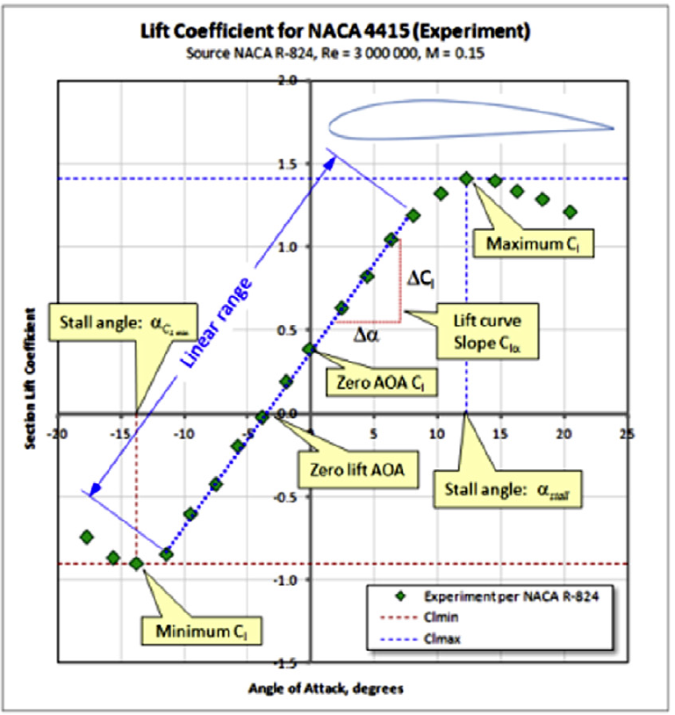
Airfoil lift: the lift curve
Airfoil lift increases linearly with AOA in the linear range.
The linear behaviour is lost starting from values of alpha close to the so called alpha stall (α_{s}), where C_{l} reaches its maximum value.
For thin airfoils in low Mach numbers the lift curve slope is 2π (per radian)
Fig. source: Gudmundsson
Notes:
The linear airfoil theory suggests that the lift generated by the airfoil will increase linearly with the angle of attack, being 2π the gradient of the lift v.s. alpha curve. In reality, the linear behaviour is lost starting from values of alpha close to the so called alpha stall (α_{s}), where C_{l} reaches its maximum value.
Of course it also exists a negative stall angle, where the a maximum negative value of lift is achieved. This might not be too interesting for the wing of normal transport aircraft, but it is for aerobatic aircraft which must flight reverted, as well as for tail lifting surfaces (the tail must be able to generated both positive and negative lift to balance the aircraft during the various flight phases.
For values of alpha larger than α_{s ,} the lift decreases, while, at the same time, the drag increases substantially because of the separation of the flow. The stall angle, is often addressed as critical angle of attack.
POINT OF ATTENTION: 2π is the highest gradient according to the “theory for thin airfoils”. However, this is true only for low mach numbers (M <= 0.2), when no compressibility effects are present! See later about the effects of compressibility.

Slide 20
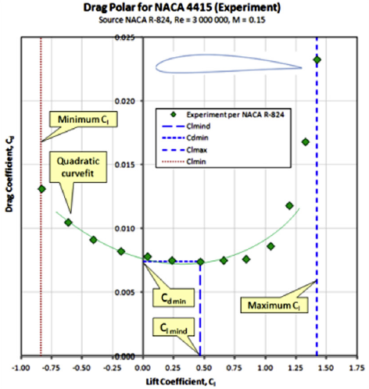
Airfoil drag: the drag polar
At low Cl values:
The friction drag is the dominant component of the airfoil drag.
The airfoil drag varies quadratically with lift
At high Cl values:
The pressure drag due to flow separation is the main component of the drag.
A quadratic drag polar is not valid anymore
Some airfoils have drag bucket
Drag does not change with lift
Airfoil design c_{l}
Fig. source: Gudmundsson
Notes:
Attention! Not all kinds of airfoil feature the so called drag bucket. The presence of a miminum plateau in the drag polar rather than just a single evident minimum, depends on the specific design characteristics of the airfoil (see later about laminar airfoils like the NACA 6 family). However in order to really show the bucket, the geometry of the airfoil is not the only factor. The Re value is important as well. Indeed there is a Re_Design value, beyond which the transition to a turbulent flow occours, with consequent “filling” of the drag bucket and enhancement of the airfoil friction drag. Also the roughness of the airfoil is determinant, hence both the manufacturing accuracy and the cleannes of the wing section (no insects and dirty) are determinant for the actual existance of the laminar bucket.

Slide 21
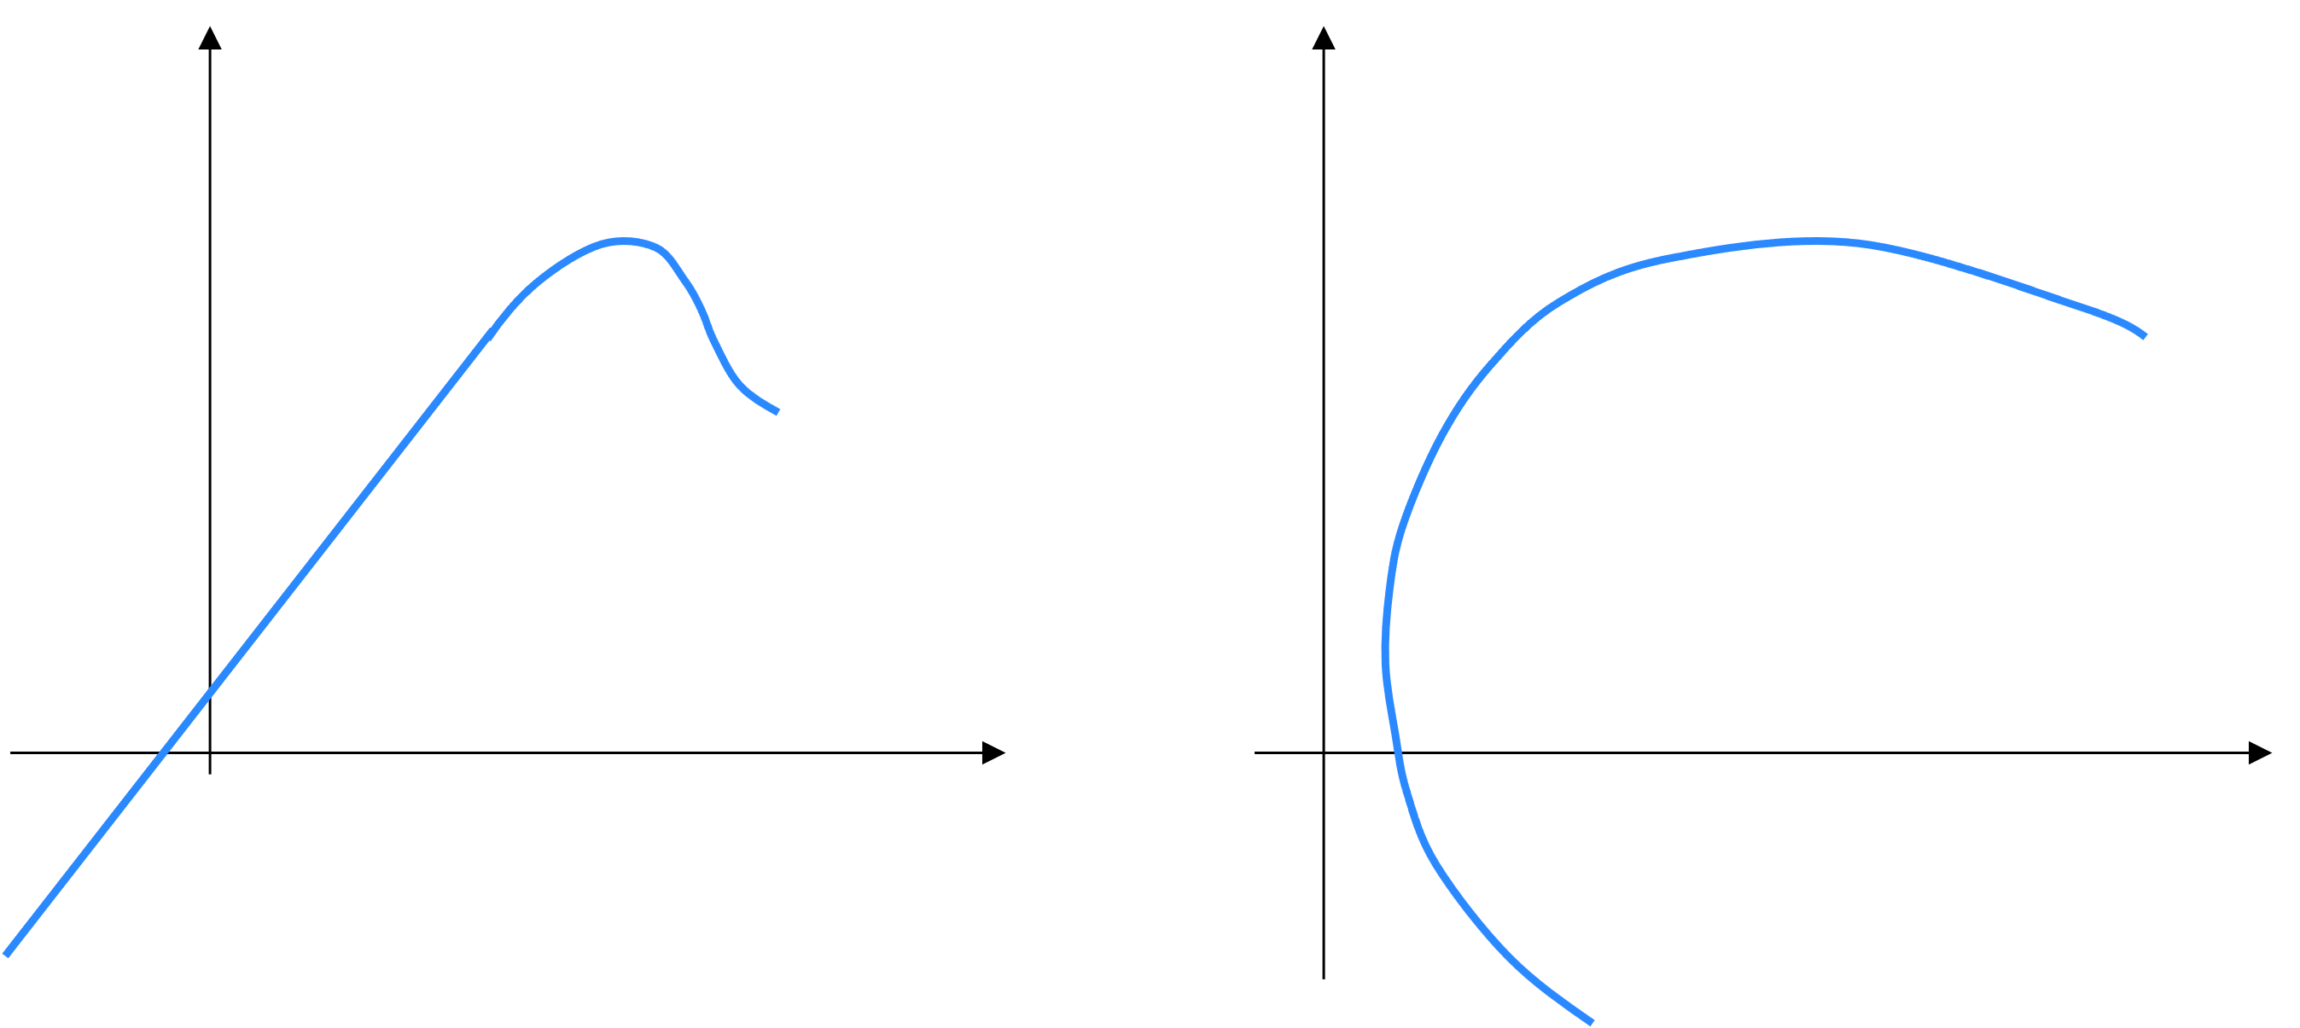
Lift curve and drag polar: important characteristics
C_{l}
C_{l}
C_{l max}
Cl @ Max(C_{l} /C_{d})
Max(C_{l} /C_{d})
C_{l des}
α
C_{d}
α_{trim}
α_{stall}
C_{d min}

Slide 22
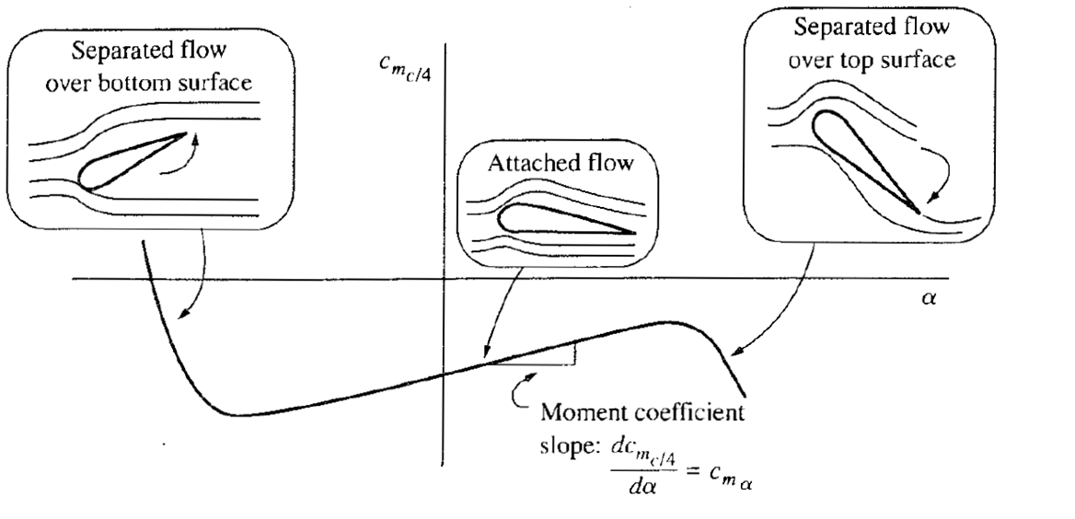
Airfoil pitching moment
A moment is be always evaluated with respect to a reference point.
Some useful definitions:
Center of pressure: it is the point where the resultant force of the pressure distributions is applied without producing any moment (similar to c.g.)
Aerodynamic center: the point where the pitching moment does not depend on the generated lift (hence also the AOA); usually it is very close to the quarter chord point.
Longitudinal stability & tail sizing will be faced in AE3211
Notes:
22
The pitching moment must be evaluated with respect to a reference point. C_{m} data typically found in literature are calculated around the quarter chord line (i.e., at 0.25C). The choice of this reference point is convenient because it is generally very close to the so called aerodynamic centre of the profile. The aerodynamic center is the point around which the moment of the aerodynamic forces does not varies with the angle of attack.
Indeed, it can be observed that the Cm-Alpha curves are generally rather flat.
The moment coefficient of “conventional airfoil” is typically negative (hence pitch down), with the tendency of becoming less negative at increasing angle of attack.
The stable or unstable behaviour at stall depends on the specific kind of airfoil.

Slide 23
Airfoil design parameters (geometry)
How do the aerodynamic characteristics of the airfoil depend on the main geometric parameters?
But first…what are the main geometric parameters we are talking about?
Effect of the airfoil camber
Effect of the airfoil (max) thickness
Effect of the (t/c)_{max} position
(Effect of the airfoil nose radius)*
Notes:
23
The airfoil nose radius is a design parameter that affects the lifting capability of the wing in terms of max lift coefficient and stall angle. This will not be discussed in this lecture, but later with the estimation of the wing maximum lift coefficient.

Slide 24
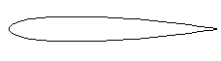
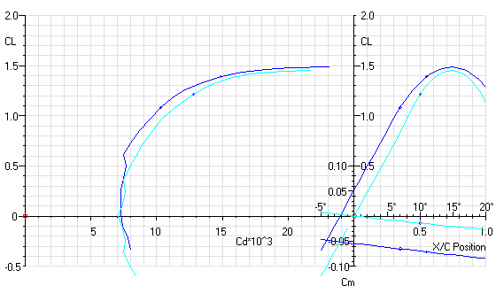
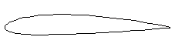

Effect of airfoil camber
C_{lα} is not affected
- curves shift for higher camber
The minimum drag condition is obtained at higher lift coefficients (Cl design increases!)
At zero angle of attack the airfoil with camber is still generating lift*
Also the amount of pitching moment increases
Notes:
24
The net effect of introducing camber is that of reaching higher values of C_{l} in correspondence of lower angles of attack.
Increasing the camber increases also the pitching moment of the airfoil. We can anticipate that this has an effect on the design of the aircraft tail. In fact, a wing with a high pitching moment will require “more work” from the tail to trim the aircraft (with the generation of the so called trim drag). The deployment of flaps has actually the same effect as increasing the camber of the wing (if there is no increase of the wing surface) and in flaps-down configuration the tail must succeed in balancing the strong increase in the wing pitching moment.
POINT OF ATTENTION: When discussing about changing the camber, it’s not only the max camber that affects the airfoil behaviour, but also the position of the camber. Bringing the camber toward the nose C_{lmax} increases, but it is not favourable for the stall characteristics. Vice versa, after positions of the camber lower C_{lmax} values but yield a more gradual stall transition.
*On trainers and aerobatic aircraft low values of camber are typically used because of the inverted flight possibility.

Slide 25
Effects of the thickness ratio (t/c)_{max}
The maximum thickness (t/c) of the airfoil and its position along the chord have direct influence on a variety of aspects:
MAXIMUM LIFT (C_{lmax})
AIRFOIL STALL CHARACTERISTICS*
DRAG (C_{d}) (also discussed later together with the compressibility effect. I.e. (t/c) effect on Mach critical)
WING VOLUME & STRUCTURAL WEIGHT (discussed later relatively to the wing characteristics)**
Notes:
25
* The stall characteristics of the airfoil (2D) of course influence the stall characteristics of the whole wing (3D) built up with that airfoil. However, a wing is generally built of different kinds of airfoils, and, in case of twist and taper ratio value different than null, each single airfoil on the wing works at different condition (different angle of attack, different Re). Also, in case of swept wing and anyhow close to the wing root and tip areas, there are strong 3D effects, which modify the way the airfoil works nominally in 2D. So the airfoil stall characteristics are not inherited right away by the wing! it’s not generally true that a wing built of medium thickness airfoils has bad stall characteristics (as discussed next slides).
** this is not really about airfoil behaviour, but wing performance, though there is a direct effect!

Slide 26
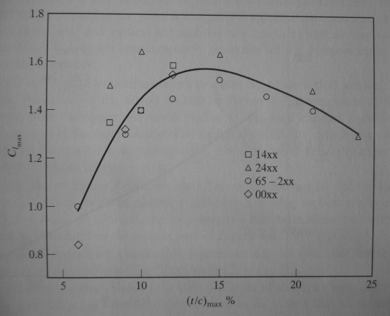
(t/c)_{max} effect on C_{lmax}
(t/c)_{max}% = 14
Source: Corke
Notes:
26
In terms of “lifting capability” there is no reason to use airfoils thicker than 14%. In fact, thicker airfoils will increase the suction peak and lower the Mach-critical. As discussed later, lowering Mach-critical is negative for high speed wings and might require the use of a sweep angle.
Under a wing-structure point of view, the use of thick airfoils is beneficial to lower the wing bending stresses (hence lower the wing weight) and/or to increase the wing volume for fuel and/or landing gears storage.

Slide 27
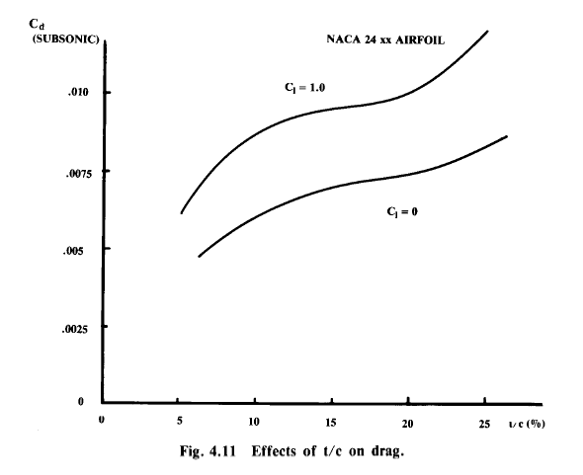
(t/c)_{max} effect on subsonic drag
C_{d} (subsonic)
(t/c)%
Source: Raymer
Notes:
27
Obviously, given two airfoils with same chord, the thicker airfoil will feature higher friction drag, because the flow will stay in contact with the airfoil over a longer distance.
Also the associated form drag is higher because of the earlier separation of the flow. Intuitively a thicker airfoil will perturb the flow more than a thinner one. Every perturbation will correspond to an amount of energy dissipated in the flow, hence drag!

Slide 28
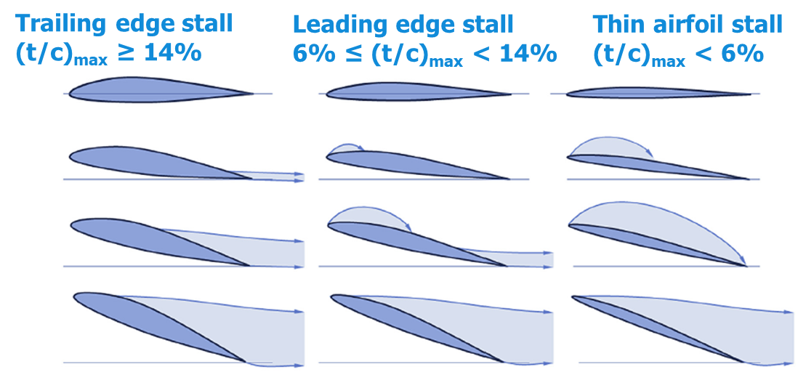
(t/c)_{max} effect on stall characteristics
Fig. source: Gudmundsson
Notes:
28
The thickness value of the airfoil (and the size of the LE radius as well) strongly determines the way the stall condition is reached, as well as the post stall condition
1) Thick airfoils (>14%) stall from the TE edge. The boundary layer thickness increases with alpha. Around 10 degree it begins to separate. The separation zone grows gradually with increasing angle of attack. The stall is gradual and the variation in the pitching moment are very small.
2) Moderate thickness airfoils (6%<t/c<14%) show flow separation at the nose already at very low angle of attack. The flow anyway reattaches very soon creating a kind of bubble. This separation bubble remains constant for quite some increments of alpha, until it suddenly bursts creating total and abrupt separation of the flow, hence a discontinuity in the lift and pitching moment. Of course a wing (3D) showing such stall behaviour would not be ideal. However the stall behaviour of a wing is generally different than that of the implemented airfoils (se note previous slide). Indeed the greatest majority of aircraft has the wing thickness included in this range!
3) Thin airfoils feature the generation of separation bubble near the LE, similarly to the medium thick airfoils. The difference is that in this case the bubble extends gradually towards the TE, when alpha increases. At that point the flow results completely separated. Large changes in the lift and pitching moment are then experienced, though the variations are gradual and not abrupt. The maximum lift coefficient achieved by this type of airfoils is less than the ones with a burst in the separation bubble. However the behaviour of the stall is more desired.

Slide 29
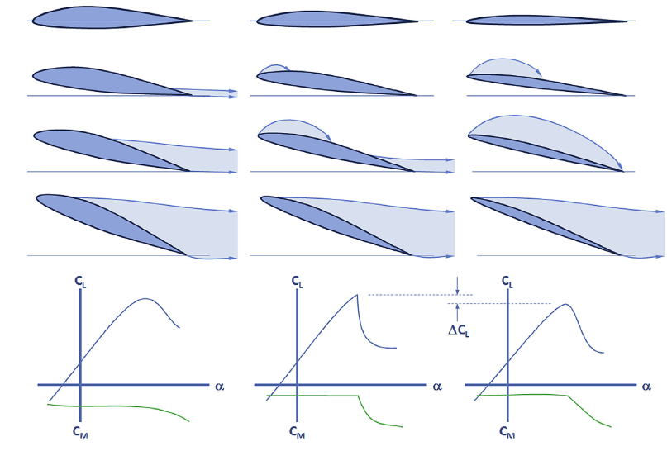
(t/c)_{max} effect on stall characteristics
Trailing edge stall
(t/c)_{max} ≥ 14%
Leading edge stall
6% ≤ (t/c)_{max} < 14%
Thin airfoil stall
(t/c)_{max} < 6%
Fig. source: Gudmundsson
Notes:
29
The thickness value of the airfoil (and the size of the LE radius as well) strongly determines the way the stall condition is reached, as well as the post stall condition
1) Thick airfoils (>14%) stall from the TE edge. The boundary layer thickness increases with alpha. Around 10 degree it begins to separate. The separation zone grows gradually with increasing angle of attack. The stall is gradual and the variation in the pitching moment are very small.
2) Moderate thickness airfoils (6%<t/c<14%) show flow separation at the nose already at very low angle of attack. The flow anyway reattaches very soon creating a kind of bubble. This separation bubble remains constant for quite some increments of alpha, until it suddenly bursts creating total and abrupt separation of the flow, hence a discontinuity in the lift and pitching moment. Of course a wing (3D) showing such stall behaviour would not be ideal. However the stall behaviour of a wing is generally different than that of the implemented airfoils (se note previous slide). Indeed the greatest majority of aircraft has the wing thickness included in this range!
3) Thin airfoils feature the generation of separation bubble near the LE, similarly to the medium thick airfoils. The difference is that in this case the bubble extends gradually towards the TE, when alpha increases. At that point the flow results completely separated. Large changes in the lift and pitching moment are then experienced, though the variations are gradual and not abrupt. The maximum lift coefficient achieved by this type of airfoils is less than the ones with a burst in the separation bubble. However the behaviour of the stall is more desired.

Slide 30
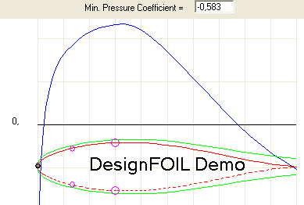
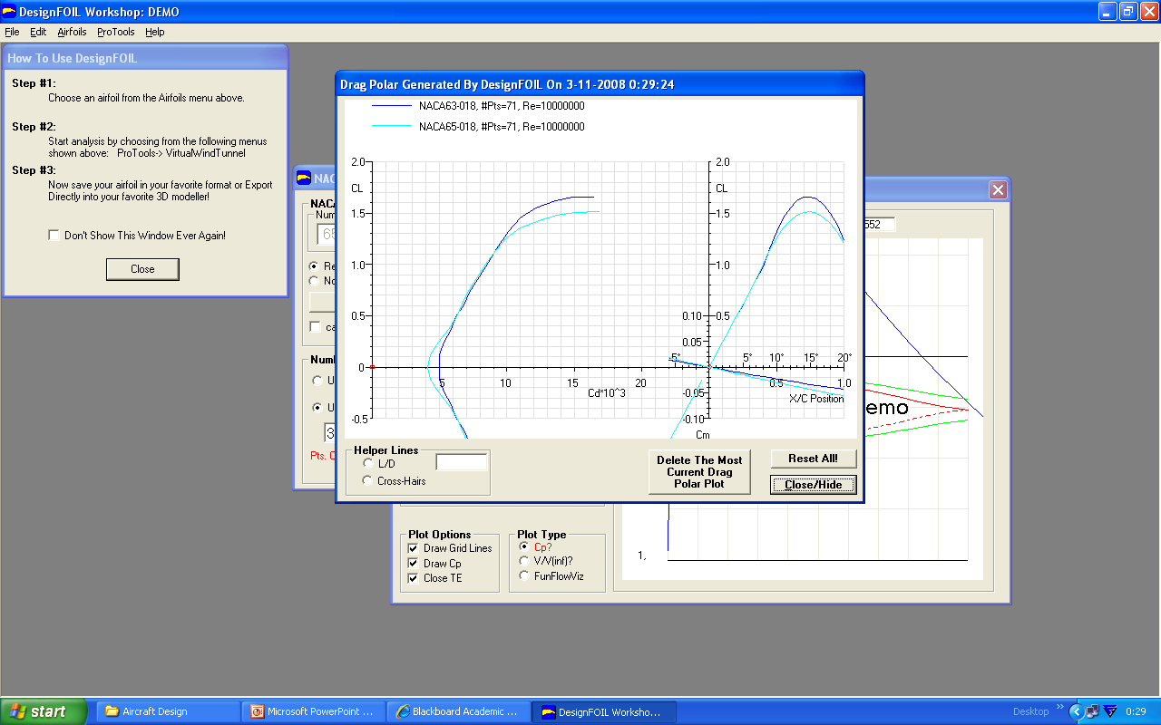
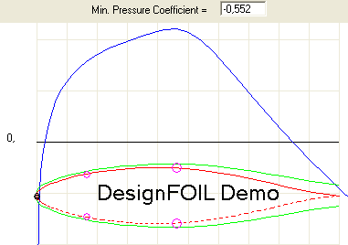
Effect of (t/c)_{max} position
The location of the airfoil max thickness is linked to the location of the max peak pressure.
Indicate effects when t/c max is shifted back
Notes:
30
The location of the airfoil max thickness has also large influence on the airfoil behaviour. Indeed, the location of the max thickness is very related to the location of the airfoil maximum pressure position. Hence the further back it is positioned:
The lower the minimum drag,
The higher the Mach critical (lower maximum pressure peak)
However…
The lower Clmax
The higher the drag increase.
The most common thickness locations are indeed around the 30-40% (rarely higher) of the chord (measured from the nose)

Slide 31

Influence on flow characteristics
The aerodynamic performance of a given airfoil depend not only on the AoA but also on the flow conditions:
C_{l}, C_{m} and C_{d} = f (α, Re, M)
Viscosity effect: Reynolds number →
*
Compressibility effect: Mach number →
Notes:
31
*As indicated above, Re is function of x, which is a geometric reference length for our airfoil, typically the chord length. Note that you will have to calculate Re, when the chord length of the airfoil to be studied is eventually not known yet! An assumptions will have to be made on the value, e.g., of the wing mean aerodynamic chord (MAC – see next lecture) and iterations might be required!
The speed V is also the freestream speed component in the plane of the airfoil! On swept wings this component is not the same as the freestream speed V∞. Again, an assumption will have to be made on the sweep angle in order to evaluate a proper value of Re. Iterations might be required in case that assumption will appear to be too far off.

Slide 32
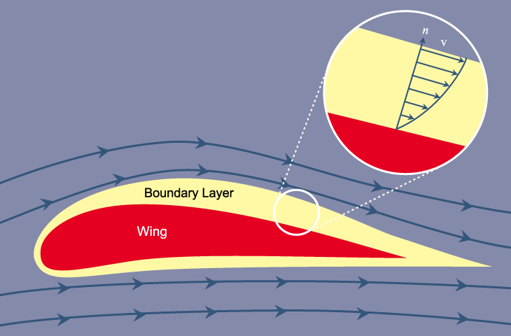
Intermezzo: fluid viscosity
The (dynamic) viscosity is a inner property of the fluid related to its resistance to the tangential deformations by shear stresses.
As a body moves within a fluid, the fluid molecules tend to remain attached to its external surface.
A layer of fluid where the velocity is strongly depending on the tangential forces can be observed. This layer, called, boundary layer, “changes” the aerodynamic shape of the body altering the lift and drag produced by the body itself.
Thickness and “type” of the BL (laminar or turbulent) is depending on the fluid and motion characteristics.
The similarity parameter for viscosity is the Reynolds number. The Reynolds number expresses the ratio of inertial (resistant to change or motion) forces to viscous (heavy and gluey) forces
Notes:
32

Slide 33
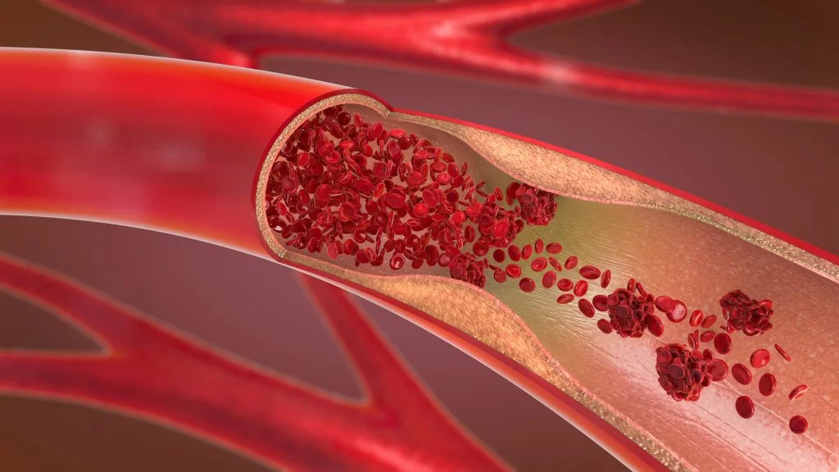


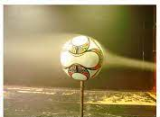

Intermezzo: fluid viscosity
10¹
10²
10³
10⁴
10⁵
10⁶
10⁷
10⁸
10⁹
Notes:
33

Slide 34
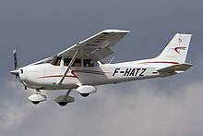
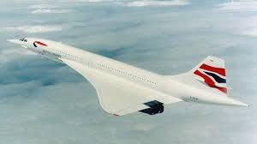
Intermezzo: fluid viscosity
10¹
10²
10³
10⁴
10⁵
10⁶
10⁷
10⁸
10⁹
Notes:
34

Slide 35
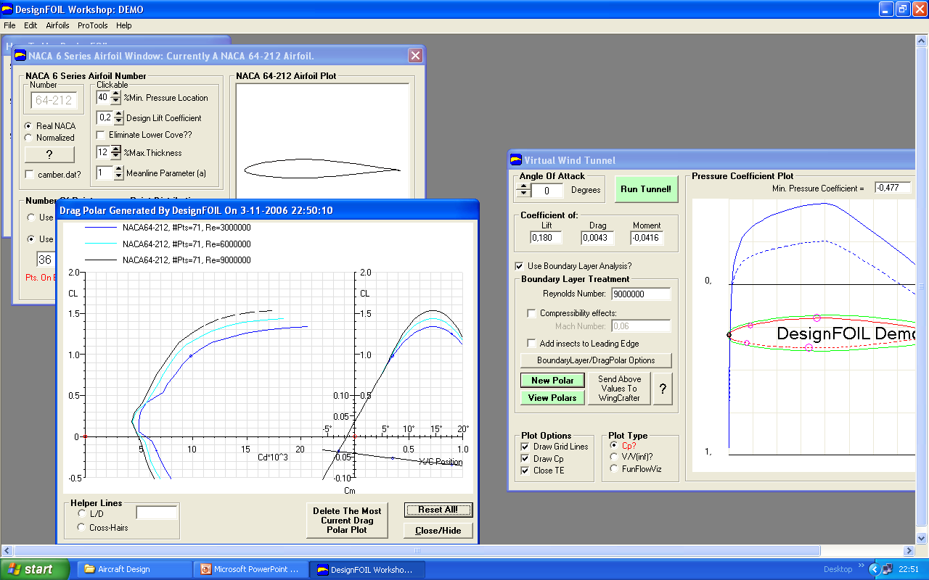
Re effect on airfoil performance (viscosity effect)
Here the effect of Re is significant.
So the low speed design is highly sensitive to the proper Re!
Friction and form drag “decrease” with higher Re
Indicate higher Reynolds numbers
N.B. linear part is not influenced!
Notes:
35
POINT OF ATTENTION: Considered the great impact of Re on Clmax, it is important that the right curves are selected when analysing the low speed wing performance. At low speed (Take off and landing), it is important the wing is able to provide the highest CLmax. Since the wing CLmax depends on the Clmax of the airfoils, it is important that the appropriate low-speed Re is used to calculate Clmax. Using the Cl-alpha curves for cruise condition would bring to a large overestimation of the actual maximum lifting capability of the wing at low speed!
From the drag polars we see the effect of Re in decreasing the skin-friction coefficient C_{f}. Attention! higher Re numbers yield lower friction coefficient values until the flow is laminar. As soon as there is the transition to turbulent, the friction increases suddenly and then begins decreasing again with increasing Re. Infact C_{f} = 1/Re^0.5 (laminar flow) and C_{f} = 1/Re^0.2 (turbulent flow).
Furthermore high values of Re allow the flow to stay attached longer (somehow the boundary layer has more energy to cope with the adverse pressure gradient), hence decreasing the drag contribution due to flow separation and increasing the maximum value of lift coefficient!
It should be noted that the effect of Re on Clmax depends also on the thickness and camber of the airfoil under consideration.

Slide 36
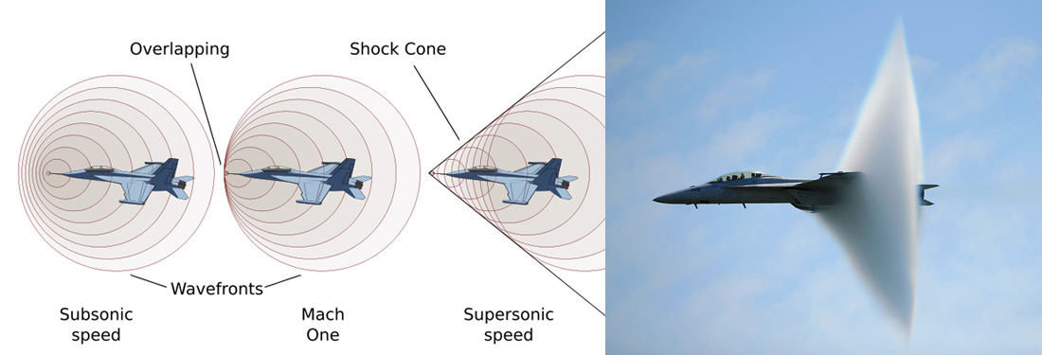
Intermezzo: fluid compressibility
Aerodynamic forces depend on the density of the fluid. At low speed, the density of the fluid can be considered constant and the presence of the moving body does not introduce significant changes.
As the body speed increases, part of its energy is spent to compress the fluid and the density changes.
The similarity parameter for compressibility effects is the Mach number, where the speed of sounds represent how fast a perturbation is transmitted through the fluid particles.
M<<1 Subsonic flow: no compressibility effects
M≈0.35-0.6 Effects of compressibility become significant
M≈0.75 transonic regime (critical Mach), shock waves start to occur
M>1 Supersonic speed; aerodynamic physic and governing equation are different
M>5 Hypersonic: thermal effects ionization and chemical processes become predominant
Notes:
36

Slide 37
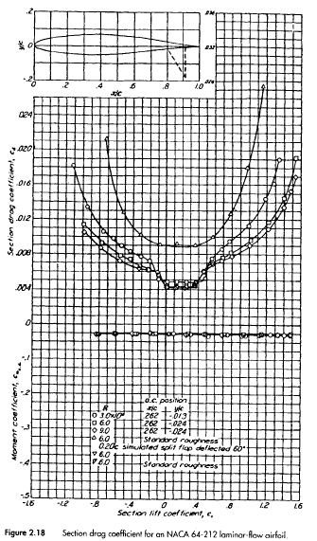
Mach effect on airfoil performance
All the experimental curves, like the one in the next figure from Abbott*, do not show any effect of the Mach number on the airfoil performance.
That’s because they were drawn with data collected in a low speed subsonic wind tunnel. No compressibility effect could be reproduced at the available speed (M< 0.2).
Indeed the aerodynamic coefficients of an airfoil change as the Mach number of the freestream flow increases!
Source Abbott
Notes:
37
* See later for the complete reference

Slide 38
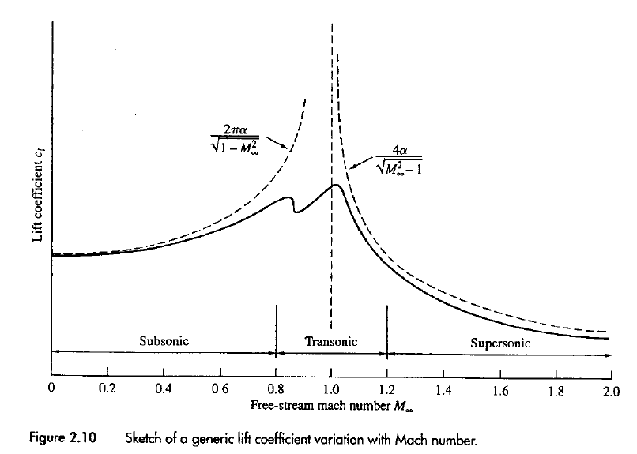

Compressibility correction methods
C_{l} grows with M (till M=1)
The Prandtl-Glauert compressibility corrections can be used for a reasonable estimation of C_{l}.
The same corrections can be used also for the airfoil moment coefficient and Cp.
Similarly we can use these corrections also for C_{L} and C_{M} (3D wing)
C_{l}
analytical curve
Experimental curve
Compressibility effects negligible
M∞
Source Anderson
Notes:
38
More complex analytical relations can be found in literature that are able to approximate the real Cl-M curve better than the P-G compressibility correction factor. However, the P-G method is one of the most simple, yet very good for the scope of conceptual design.

Slide 39
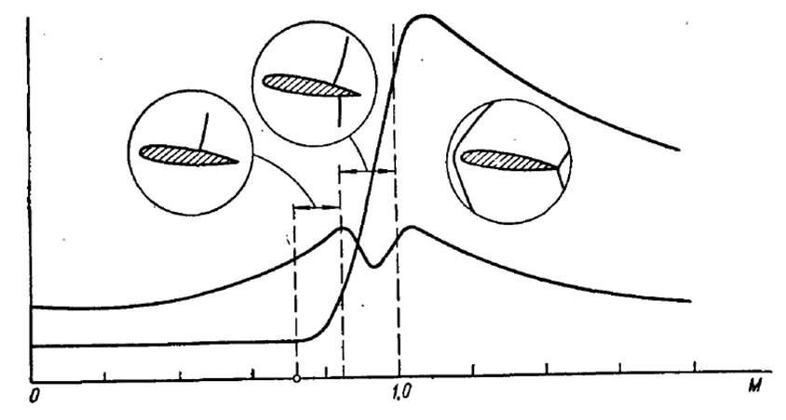
Mach effect on airfoil performance
Cl
Cd
Cd
Cl
Mcr
Notes:
Effect of Mach number on LIFT
In the incompressible region (M<0,3) the lift is almost constant. However by further increasing the Much number the lift start to increase. The reason is the additional flow acceleration due to the compressibility. At critical Mach number the first point on the (upper surface) of the airfoil reaches M=1. Br increasing the Mach number (M>Mcr) the region of supersonic flow grows on the upper side of the airfoil resulting in further pressure drop and increas in the lift. However at some point flow on the lower surface of the airfoil also becomes supersonic. This results in flow acceleration and pressure drop on the lower surface of the airfoil so lift decreases. By further increasing the Mach number the whole lower surface of the airfoil experiences supersonic flow, however some part of the upper surface still has subsonic flow. So by increasing the Mach number the lift again increases. After M=1 both upper and lower sides of the airfoil have supersonic flow (except a small region in front of the leading edge). Increasing the Mach number further reduces the lift.
Effect of Mach number on DRAG
The behaviour of C_{d} at growing Mach is different than C_{l}.
C_{d} remains constant until, in correspondence of a certain Mach value (smaller than 1!) the sonic conditions are reached locally on one point of the airfoil. Before that, the drag is mainly due to friction. Compressibility does not have a relevant effect on friction drag.
After the critical conditions are reached a pocket of supersonic flow starts growing on the airfoil (sometimes also on the lower part of the airfoil). A shock wave is formed at the end of this pocket (after that the flow returns subsonic), which contributes to enhance the drag (wave drag contribution). As the shock wave grows, the large adverse pressure gradient associated to the flow recompression creates a growing separation of the flow. This large flow separation is responsible for the deep increase of the drag!
POINT OF ATTENTION: We can say that Mcritical (often addressed in literature as M_{cr} or M_{CC}, i.e. Mach crest critical, because the critical conditions are reached in correspondence of the peak or crest of the pressure distribution on the airfoil) is a kind of warning value! The actual drastic drag increase is encountered at Mach values slightly higher than Mcr, i.e. in correspondence of the so called M_{DD} (Mach drag divergence), or simply M_{div}. For conventional airfoils M_{div} is 2-4% higher than M_{cr}. As discussed later, special airfoils, so called supercritical, can push Mdd further to values about 6% higher than Mcr!

Slide 40
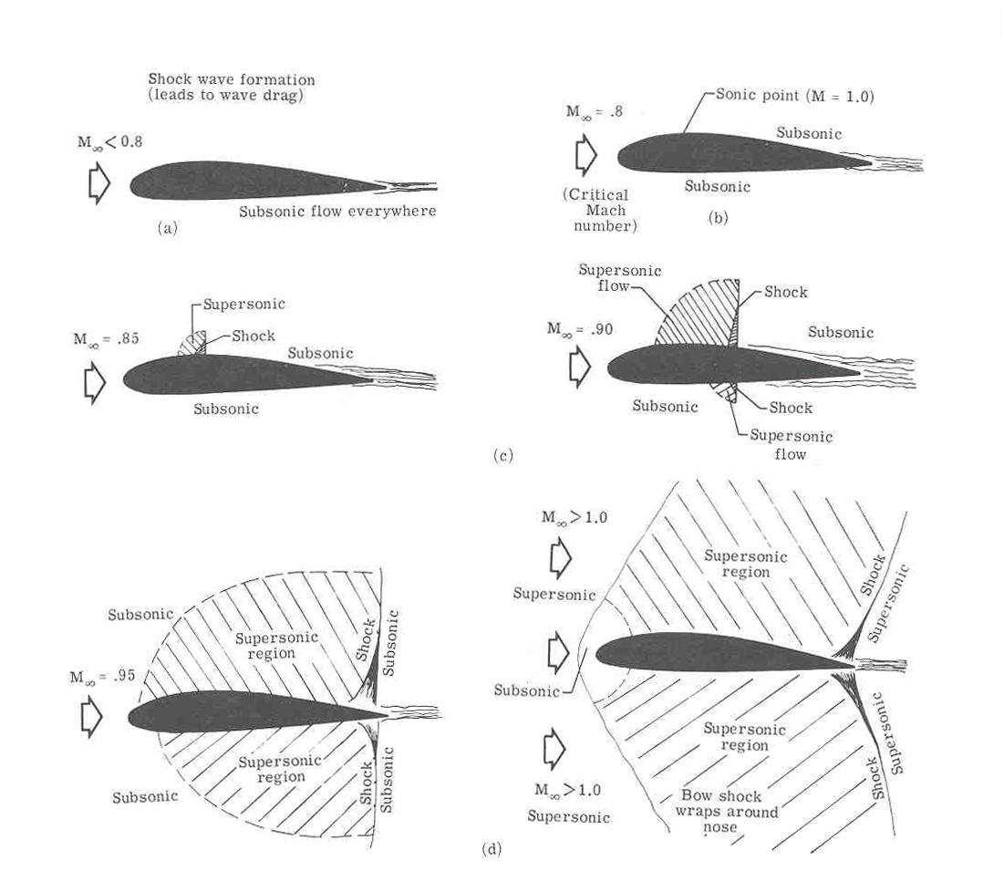
Airfoil critical Mach number
The airfoil critical Mach number is the freestream Mach number at which the flow velocity on the airfoil reaches the speed of sound.
After the sonic conditions are reached on the airfoil, a further increase in the freestream velocity causes the generation of shock wave(s).
The recompression after the shock wave induces boundary layer thickening and then major flow separation.
This can lead to the occurrence of buffeting and then to high speed stall

Slide 41
Relevance of the airfoil critical Mach number
Since different airfoils accelerate differently the flow around their boundary, it is intuitive that different airfoils have different values* of M_{cr}
How to make sure we are using airfoils with adequate M_{cr} for our mission?
Mcr for an airfoil can be determined in three ways:
Look at statistics, historical trends and reference aircraft (good to get a rough feeling)
Use experimental data (when available!) showing the variation of critical Mach with different airfoil shapes and thickness
Calculate the actual M_{cr} of the given airfoil!
Notes:
41
* ATT. The value of the minimum pressure coefficient (hence of Mach Critical) depends also on the angle of attack at which the airfoil is operating! The higher alpha, the more negative the peak pressure coefficient, hence the lower Mach critical

Slide 42
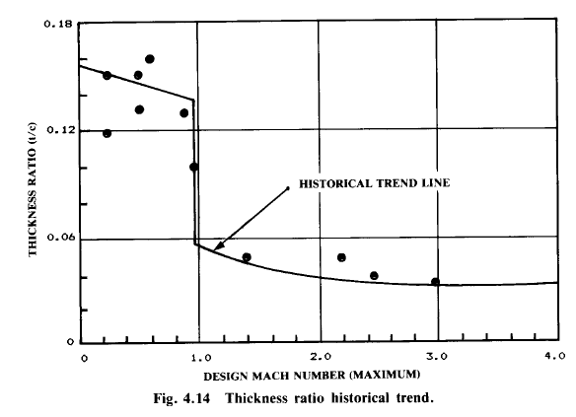

Historical trend of (t/c)_{max} and M_{crit}
Historical trend of (t/c)max on the main wing of aircraft as a function of their maximum design Mach number.
t/c=0.15
M=0.8
Source Raymer
Notes:
42
Attention: in this picture it is not shown any information concerning wing sweep angle values required to use such thickness values! E.g.,a t/c value of 0.15 is normal for Mach values around 0.8, however NOT for unswept wing!!!
The same data are plotted in fig 4.5. of Corke, nevertheless a different trend curve has been built, which does not show (like in the picture above) the discontinuity in the (t/c) values which do not really go below 12% for design MACH<1, while they are always below 6% for supersonic cruise speed.

Slide 43
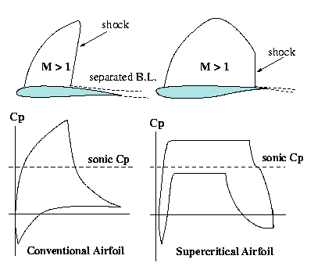
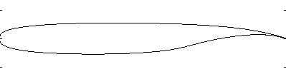
Intermezzo: Supercritical airfoils
These airfoils are designed to delay the transonic drag rise (M_{DD}), due both to strong normal shock and shock-induced boundary layer separation (actually also M_{cr} is enhanced).
Whitcomb supercritical airfoil
As compared with a conventional airfoil, a supercritical airfoil has a smaller camber, a larger leading edge radius, a small surface curvature on the suction side and a concavity in the rear part of the pressure side.
Notes:
43
The shape of a SC airfoil is such that, on the suction side, the steep supersonic acceleration of the conventional airfoil is eliminated. The flow reaches supercritical speed, that is maintained over a large part of the airfoil. Then there is a small pressure plateau behind the shock and a pressure recovery in the trailing edge region. The reduction in local Mach number reduces the strength of the shock when the flow decelerates below critical speed. Aft loading and relatively high pitching moment values are other characteristics of supercritical airfoils. This has strong influence on the design of the tail, which has to counterbalance a stronger wing pitching moment than in case conventional airfoils are used, hence increasing the trim drag contribution.
The first supercritical airfoils were designed and analyzed by Whitcomb at NASA Langley in the 1950s.
Source http://aerodyn.org/HighSpeed/supercritical.html
A number of supercritical airfoils are also available in the airfoil archive posted on BB, including the Whitcomb airfoil and some of the NASA supercritical airfoils family (those coded as SC(X)-XXXX, where the first two digits (after the -) represent the design lift coefficient and the last two digits represent the max thickness of the airfoil. You can download the NASA official report at http://ntrs.nasa.gov/archive/nasa/casi.ntrs.nasa.gov/19900007394_1990007394.pdf)

Slide 44
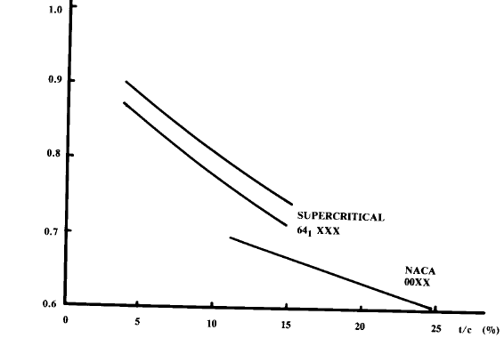
(t/c)_{max} effect on M_{cr} for different airfoils families
Curves from experimental data (zero lift)
Airfoil M_{cr}
Supercritical
10%
NACA 64₁ XXX
NACA 00XX
(t/c)%
Source Raymer
Notes:
44
Note how, for the same value of Mcr, supercritical airfoils can be 10% thicker than conventional airfoils (conventional airfoil thickness ratio times 1.1) which is advantageous in term of weight and space for fuel, landing gear, systems etc. We can also read the graph like this: supercritical airfoils have a higher Mach critical values than other NACA 4, 5, 6 families of the same maximum thickness!
Note also how series 6 airfoils, of the same thickness as NACA series 4 and 5 airfoils, have a far higher Mcr.

Slide 45
1.2: Wing Aerodynamics
Notes:
45

Slide 46





Planform geometry definition
The half-wing planform can be considered a trapezoid.
Most of the commercial airplane have a kink: in this case the geometric properties can be computed considering two trapezoids
Att! : mac, mgc,… depend on the geometry!
Notes:
The geometric parameter and the aerodynamic properties of the wing depend heavily on the planform. Thus, the relations reported on the slide are valid only for the trapezoidal wing and they cannot be applied in the case, for example, of the kinked wing. A general definition of the mean aerodynamic chord and its location are available in literature (see for instance Raymer or Torenbeek).

Slide 47

MAC in the kinked wing

Slide 48



The Mean Aerodynamic Chord
Definition:
The chord of an equivalent untwisted, unswept and non-tapered wing, for which the total lift and pitching moment are essentially equal to the lift and pitching moment on the actual wing. In other terms, it is a 2D representation of the aerodynamic characteristics (both forces and moment) of the actual wing.
$$mac=\frac{2}{S}\int_{0}^{b/2}{c^{2}\left(y\right)dy}$$
Its length and its position ($x_{mac}$ and $y_{mac}$) are extremely important for balance, stability and controllability characteristics.
The general equation can be solved for certain wing planform…
Notes:
48

Slide 49


Theoretical wing vs exposed wing
b is the wing span, i.e., the wing length measured from tip to tip
b < 80m
Fuselage diameter d
Notes:
In order to operate in common airports (manoeuvre on the ground, approach the terminal areas, enter hangars for maintenance) the maximum span length that is allowed today is 80m. This has to be considered as the max value possible for b in your wing design!

Slide 50


Effect of the finite wing on lift generation
At the tip of the wing air from the lower side of the wing (at higher pressure) tends to escape to the upper wing surface, where the pressure is much lower.
This phenomena locally decreases the lift.
In addition, tip vortexes are generated, which propagate downstream and locally affect the airflow velocity.
A downwash velocity component w_{i} is generated, which affects the aerodynamic flow around the wing.

Slide 51
The double effect of the wing tip vortexes generation
1. The effective angle of attack is reduced by the downwash velocity component w_{i}, hence for the same geometric angle of attack α, the effective angle of attack is equal to α_{eff} = α – α_{i}. Therefore, less lift is generated.
D_{i}
L
2. The lift force (by definition the component of the aerodynamic forces resultant, orthogonal to the effective freestream) tilts backward by the induced angle α_{i}, hence a drag component is generated. This is the so called induced drag component D_{i}
α_{i}
α
V_{eff}
α_{eff}
W_{i}
α_{i}
V∞
Notes:
Induced Drag, is also addressed as Vortex Drag.

Slide 52


An important result on the finite wing
From the theory of finite wing aerodynamics (lifting line theory) a practical result should be considered in the preliminary A/C design:
For a given total lift (and fixed wingspan) there is an optimal lift distribution over the wingspan that minimizes the induced drag: its “shape” must be elliptical
On the design point of view, this optimal condition can be obtained in different ways:
Elliptical chord distribution
Proper twist and taper ratio combination (see next slides)
Notes:
Induced Drag, is also addressed as Vortex Drag.

Slide 53
Geometric parameters affecting the aerodynamic curves
Aspect Ratio
Taper Ratio
Airfoil twist distribution
Sweep Angle
Wing incidence
Wing lift & drag
Stall characteristics
Critical Mach and drag rise
Aircraft (& fuselage) incidence

Slide 54


Wing Aspect Ratio
The wing aspect ratio simultaneously affects:
Wing induced drag
Wing lift curve slope
Wing stall angle
Fig. source: Gudmundsson

Slide 55

Wing Aspect Ratio
The wing aspect ratio simultaneously affects:
Wing induced drag
Wing lift curve slope
Wing stall angle
Fig. source: Gudmundsson

Slide 56

Wing Aspect Ratio
How designers exploit the effect of A on stall?
High stall AoAs
Low weight
Good gust response (low load factors)
Used in H and V tails
High Clmax
High Clalpha
Great gliding
Main wing and canard
Notes:
On a correctly designed canard aircraft the canard wing stalls before the main wing, so that the aircraft will pitch down, hence reducing the angle of attack and automatically recovering from stall. High(er than the wing) aspect ratio allows generating a lot of lift at low angles of attack and stall before the wing.

Slide 57

Impact of aspect ratio on the properties of the wing

Slide 58

Wing Taper Ratio
The taper ratio is the main design parameter to control the lift distribution along the wing span
For an unswept wing at λ = 0.4 the lift distribution is almost elliptical. The increase in lift induced drag is less than 1% higher than the value associated with the optimal elliptical distribution.....but the manufacturing of such trapezoidal wing is far easier!!
Fig. source: Gudmundsson

Slide 59

Wing sweep angle
Sweep angle is mainly used to increase the wing critical Mach number.
M_{cr_swept} = M_{cr_unswept} cos Λ
The maximum lift coefficient is reduced with an increase in wing sweep angle
The sweep has very important effect on structural loads*. Increasing the wing sweep angle increases the wing structural weight.
Notes:
*The sweep has very important effect on structural loads. Cambered airfoils inherently generate a pitching moment
about their quarter chords whose tendency is to rotate the airfoil LE down. All flapped airfoils, cambered or not,
generate extra pitching moment (torsion), which is added to the baseline moment. The total moment, regardless of
composition, is reacted as shear flow in the wing structure. If the wing is swept aft, an additional and usually
much larger pitching moment is generated because of the center of lift being moved a large distance aft.
Consequently, the swept wing structure will be heavier than a straight wing designed for the same flight condition.
Similarly, a forward-swept wing may also introduce a large LE up torsion, if the sweep angle is large enough, although this is reduced by an amount corresponding to the innate torsion of the airfoils of the wing.

Slide 60

Wing design - summary
Fig. source: Nicolai

Slide 61


Wing twist
There are generally two reasons for using wing twist:
To prevent the wingtip region from stalling before the wing root
To modify the spanwise lift distribution to help achieve minimum drag at mission condition
Geometric twist: the angle measured between the airfoils’ chords (typically between the root and tip airfoils)
Aerodynamic twist: is defined as the angle between the zero-lift angle of an airfoil and another
Fig. source: Gudmundsson
Notes:
Generally, twist angles values less than 5 degrees are used, to avoid drag increase when the wing is not operating at C_{Ldesign} (for which the twist has been optimised). -3 degrees is a typical twist angle value to avoid wing tip stall.

Slide 62

Wing stall
Design goal: for conventional aircraft configuration the stall pattern on the wing should always begin at the root and progress toward the tip as angle of attack increases.
Why?
Wing tip stalled
L_{wing}
L_{wing}
L_{tail}
L_{tail}
W
W
Balanced aircraft
Aircraft pitches up (angle of attack grows further)
Notes:
When the wing tip has stalled the lift force component generated by the wing suddenly decreases (because a smaller part of the wing contributes to the generation of the lift) and its application point moves forward, towards the aircraft center of gravity (see in the picture above how the wing aerodynamic center moves inboard and forward). This situation creates a forces unbalance such that the aircraft will tend to descend (because of the loss of net lift) and pitch up (i.e., put the nose up, because of the forward shift of the aircraft center of pressure)….hence, further increasing the wing angle of attack and further worsening the stall situation!
Note that the right and left tip sections do not necessarily stall simultaneously, as a consequence when one of the two wing halves stall, the aircraft will roll. The pilot will not have the possibility to correct that when the ailerons are located in the stalled area! That is why tip stall in general is extremely dangereous and required design actions to be corrected.

Slide 63


Pitch up
F-100 Super Sabre
F-101 Voodoo
Many early swept wing aircraft were suffering of tip stall and pitch up problems. Designers learnt how to design pitch up free aircraft, or to take adequate countermeasures.
Notes:
Many of the early swept wing aircraft (typically military vehicles), as the Super Sabre F100 and the F-101 Voodoo, were lost due of the pitch up phenomena. This was particularly dangerous at landing when the pilot had no time to recover or eject (see movie of the Super Sabre crash at https://supersabresociety.com/sabre-dance-history ).
Horns, buzzers and stick shakers were used to warn the pilot of entry into the wing-stall region.
Due to the discovery (in the hard way) of the pitch up tendency of the super Sabre, the pitch up instability mode was addressed as the Sabre dance.

Slide 64


Stall progression pattern
Fig. source: Gudmundsson
Notes:
In a swept wing when stall starts at the tip and progresses toward the root, there is always the risk of pitch up problem. If the wing is tapered, the Reynolds number at the tip is lower than the Reynolds number at the root so Clmax of the airfoil at the tip is lower than Clmax of the root. It means that the stall will start at the tip. To avoid this problem the taper is combined with twist. So it means if you decrease the taper ratio of the wing (lowering the Reynolds number of the tip) you need to use higher negative twist at the tip. So the local angle of attack of the tip is always lower than the root. It helps to avoid stall at the tip.
The wing stall can also be tailored using different airfoil at root and tip. The airfoils should be selected in such a way to ensure that the wing tip stalls after the wing root. For that, the airfoil at the tip should have higher Clmax than the airfoil at root. If this is achieved the wing can be design with lower (or even without) negative twist at the tip.

Slide 65

Wing planform design to avoid pitch up
The pitchup tendency of swept wing is such that proper combinations of wing aspect ratio and sweep angle have to be chosen in order to guarantee stability at (and after) stall conditions.
To avoid pitch up:
Source: Gudmundsson

Slide 66

Wing incidence angle
The wing incidence (i_{w}) is the pitch angle of the wing with respect to the fuselage. Typically it is measured between the wing root chord* and a fuselage longitudinal reference plane (e.g. the fuselage floor).
Angles of wing incidence in the order of 1-2 degrees are typical
i_{w}
Fig. source: Gudmundsson
Notes:
* In case of twisted wings, the incidence angle should be evaluated with respect to the zero lift angle of the wing, rather than the root chord
This angle is selected such that when the wing is at the incidence angle required by C_{Ldesign} (α_{trim}), the fuselage is not at an angle which …makes difficult to flight attendants to push food carts!
During cruise the fuselage can be kept slightly nose up to contribute to the lift generation.

Slide 67
4: Airfoil/Planform design guidelines
Notes:
67

Slide 68







Airfoil selection
The first step in airfoil selection is to determine the design lift coefficient of the airfoil.
The design lift is the aircraft lift at the most fuel intensive segment of the aircraft mission, i.e. The flight condition at which the aircraft is supposed to fly most of the time
Aircraft lift is equal to the aircraft weigh
L_{tot} = W_{@fuel-intensive-mission-leg}
For conventional aircraft configuration we can ssume:
L_{wing} ≈1.1 L_{tot.}
where the extra 10% is to compensate for the negative lift contribution generated by the tail to trim the aircraft.
Notes:
Dor pass

Slide 69
Design lift coefficient for a transport aircraft
The required wing lift coefficient can be calculated as follow:
Weight is changing during the mission: an average weight should be considered!

Slide 70
Airfoil selection
The airfoil lift coefficient can be related to the wing lift coefficient as follows:
The use of q_{eff} is important to account for the effect of the
wing sweep. In fact, an airfoil operating at an angle with respect to the freestream, needs a higher C_{l} value to match the required wing C_{L.}
Where
With

Slide 71
Airfoil selection – step by step
Assume a given thickness to chord ratio, due to other reason (i.e. structural strength).
Determine the airfoil design lift coefficient from the Aircraft Design Lift Coefficient
Select in literature a set of possible airfoils (3-5) that could match the requirements
For the given C_{ldes} look for the airfoil with minimum drag at C_{ldes} (and the widest possible drag bucket around C_{ldes}).
Look at other important off-design parameters:
Clmax and stall behavior
Efficiency @ design condition
Max Efficiency (and Cl @ Max Efficient
Perform a trade off analysis

Slide 72

Fig. source: Gudmundsson

Slide 73


Where to find information about airfoils characteristics E.g. lift and moment curves and drag polars
Theory of wing sections, by Abbott and von Doenhoff is one* of the best literature sources for standard airfoils.
Notes:
73
See also on Raymer, Appendix D on airfoils data.
ATT! Check the content of the folder Airfoils data, tools and info posted on BB.
Among others, there you can find a large airfoil archive. You can use DesignFoil to visualize them directly, or javafoils (you will have to copy and paste the content of the .dat files). In the same folder, information/instructions are provided on the use of a few simple panel codes for airfoil analysis.

Slide 74



How to compute yourself the characteristics of an airfoil
In case you do not have appropriate reference data describing the characteristics of your selected airfoils, you will need to calculate them by yourself¹. For this you can make use of some simple panel code.
Instructions to download software and quick reference guides are provided in the fourth lecture of this course
Notes:
74

